Slide 1
Team 2 Final Presentation Inwood Bagels Website
Gaëlle GIlles, Masha Obaturova, Noah Ponticiello, Charles Adams, Nandu Devarasetty, Abhilash Gubbala, Brinda Pathuri, Hemaswi Gorrela

Slide 2
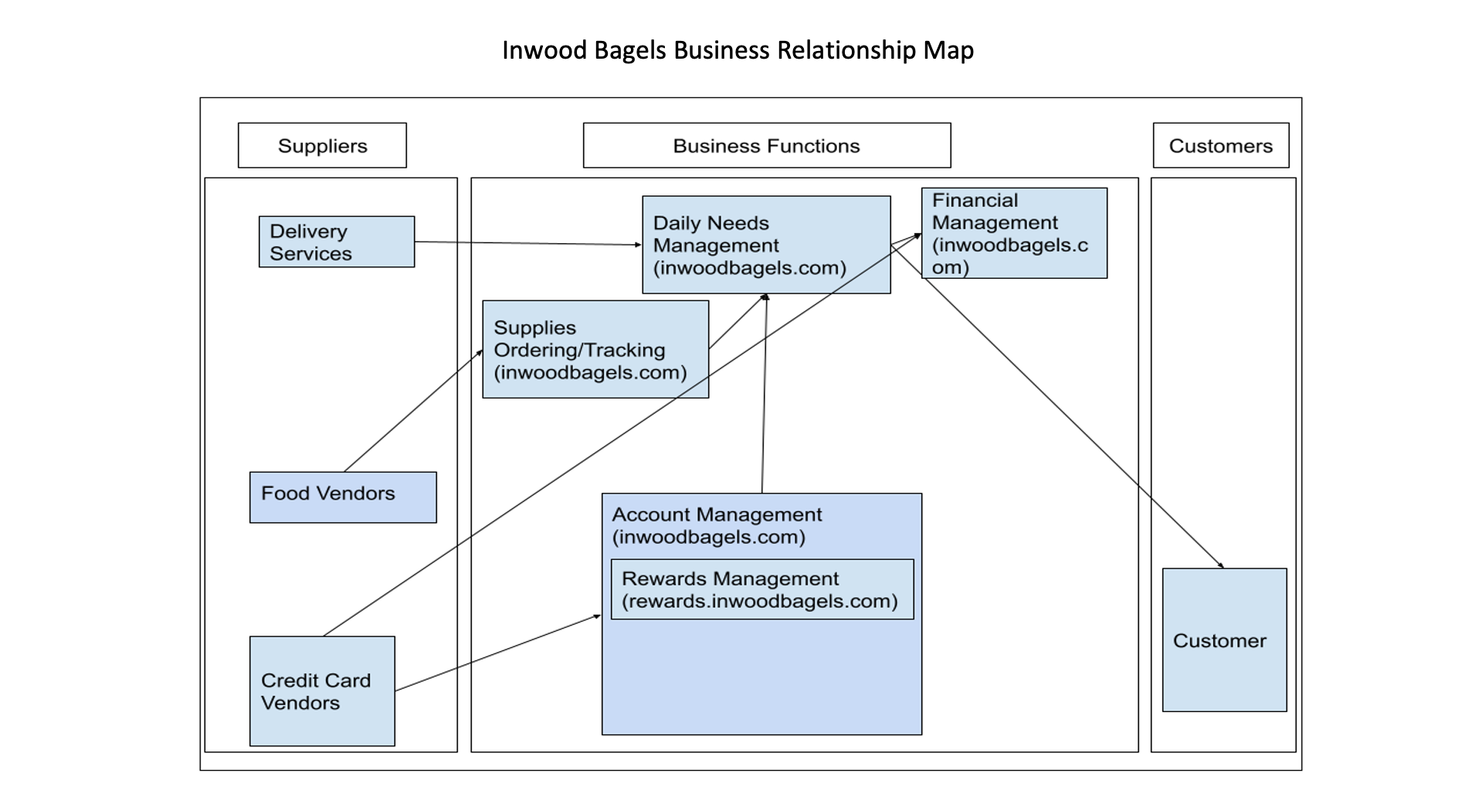
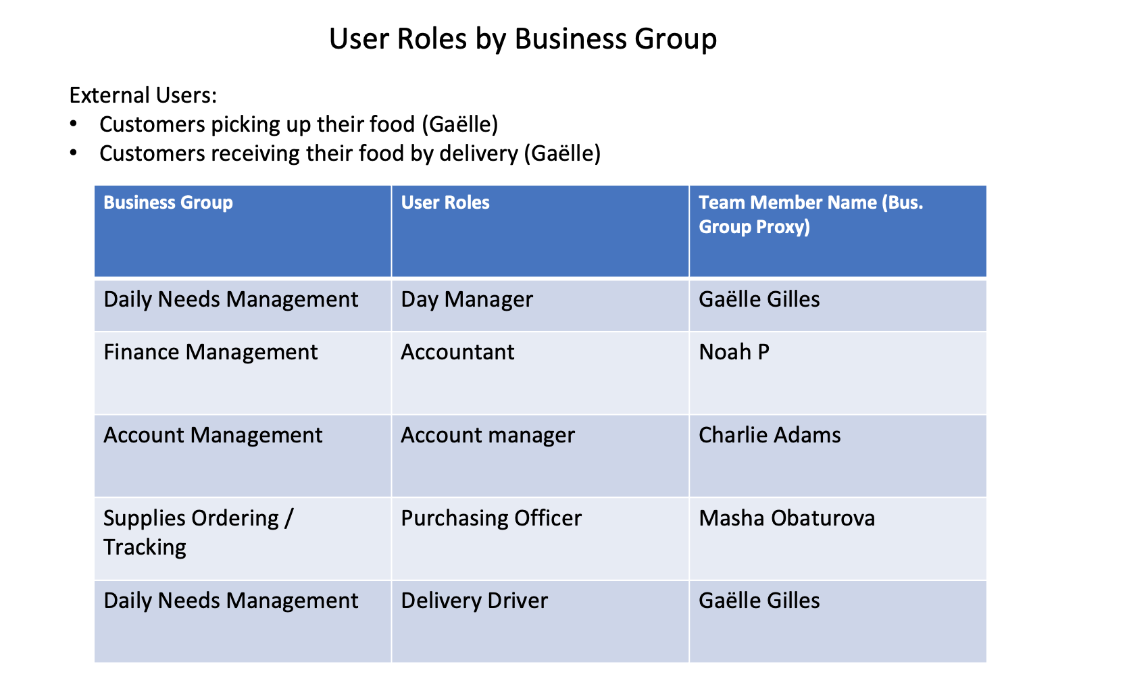
BRM Diagram - Charlie

Slide 3
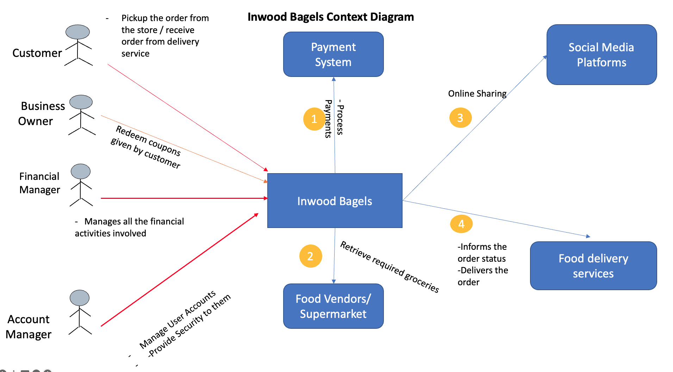
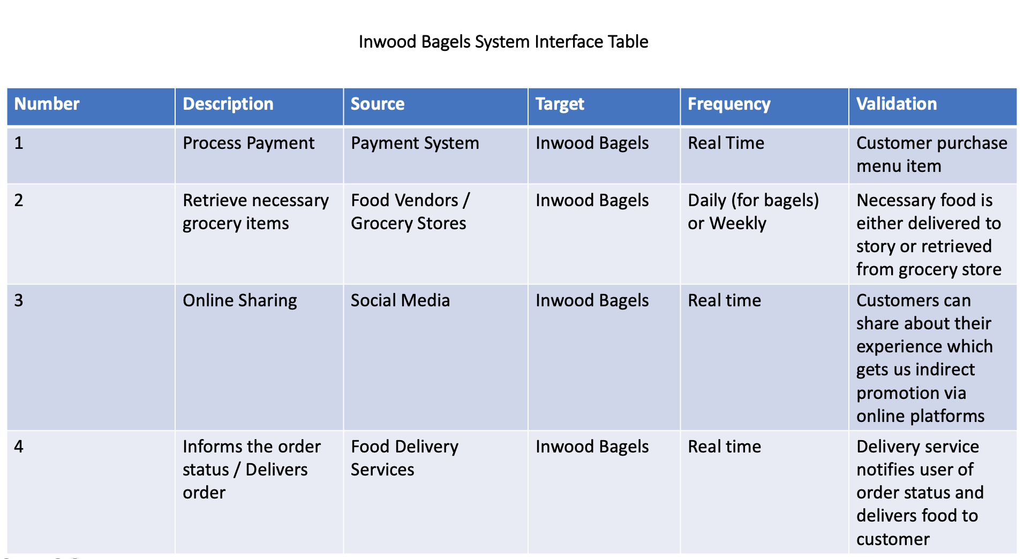
Context Diagram - Brinda

Slide 4
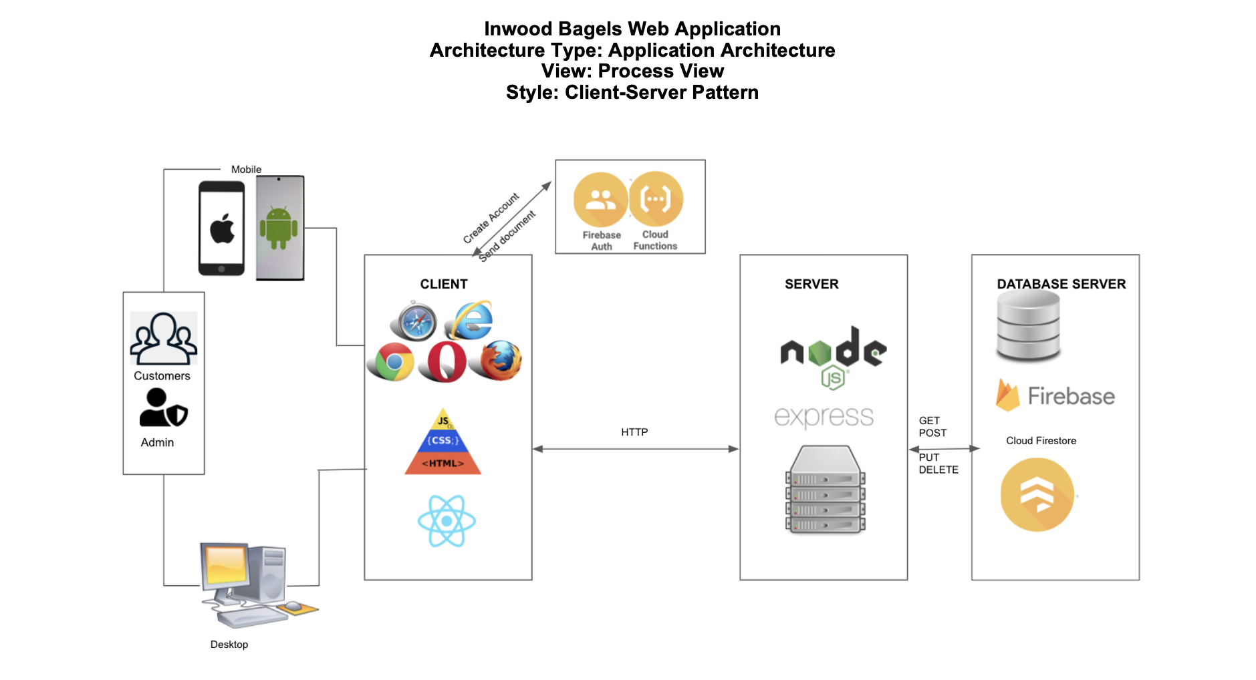
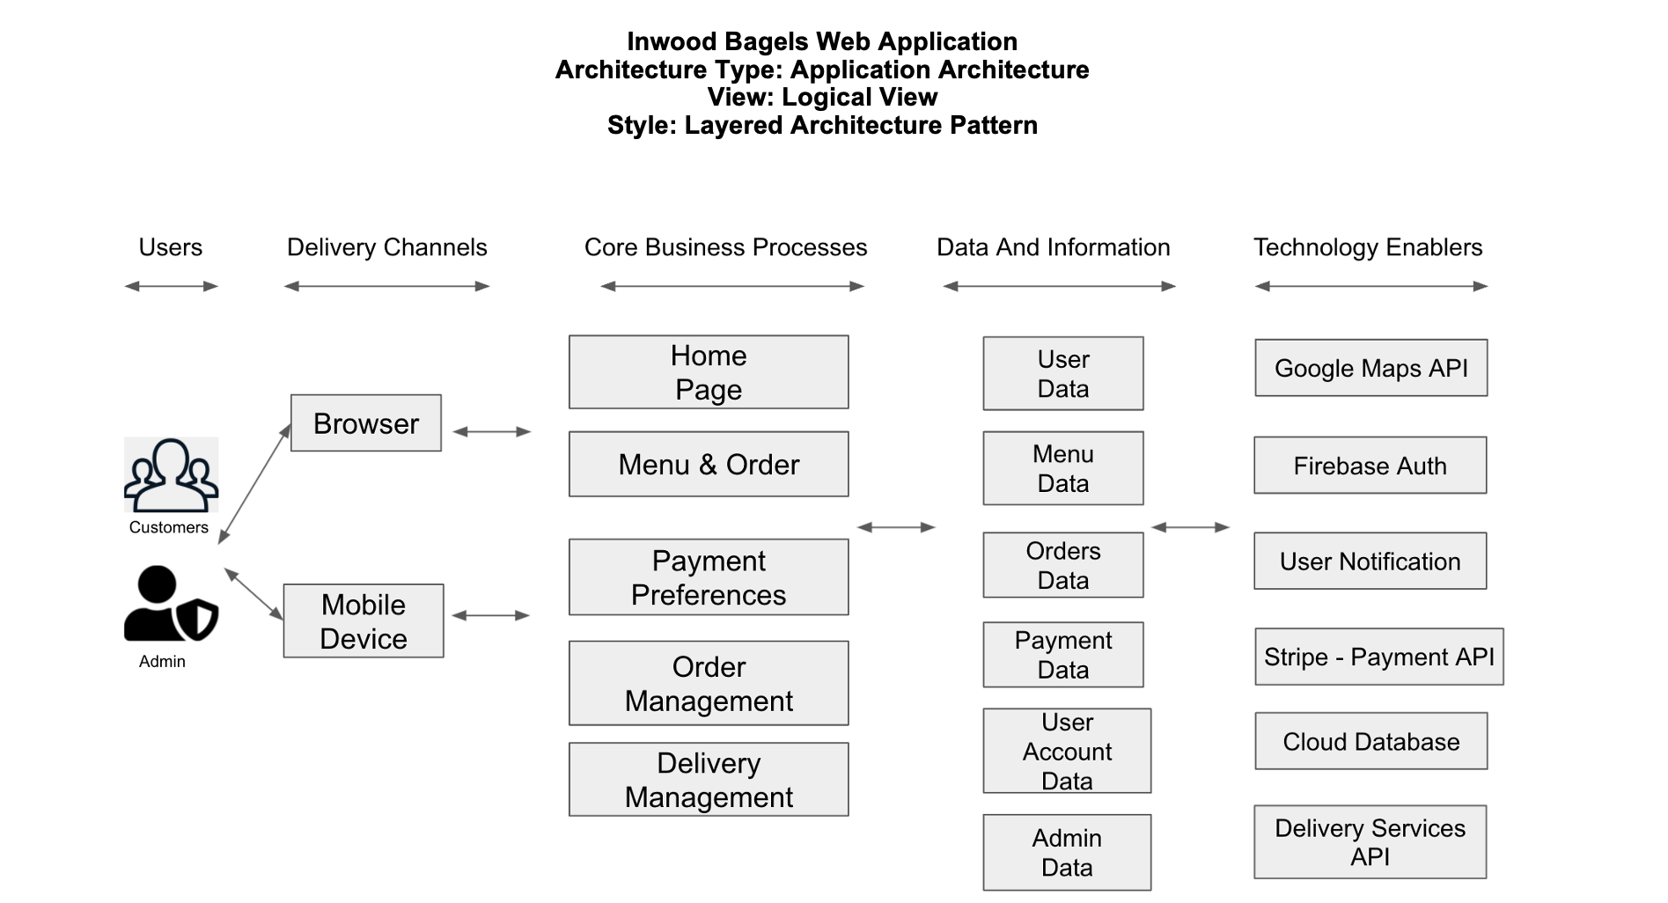
Architecture Diagrams (Logical & physical) - Noah

Slide 5
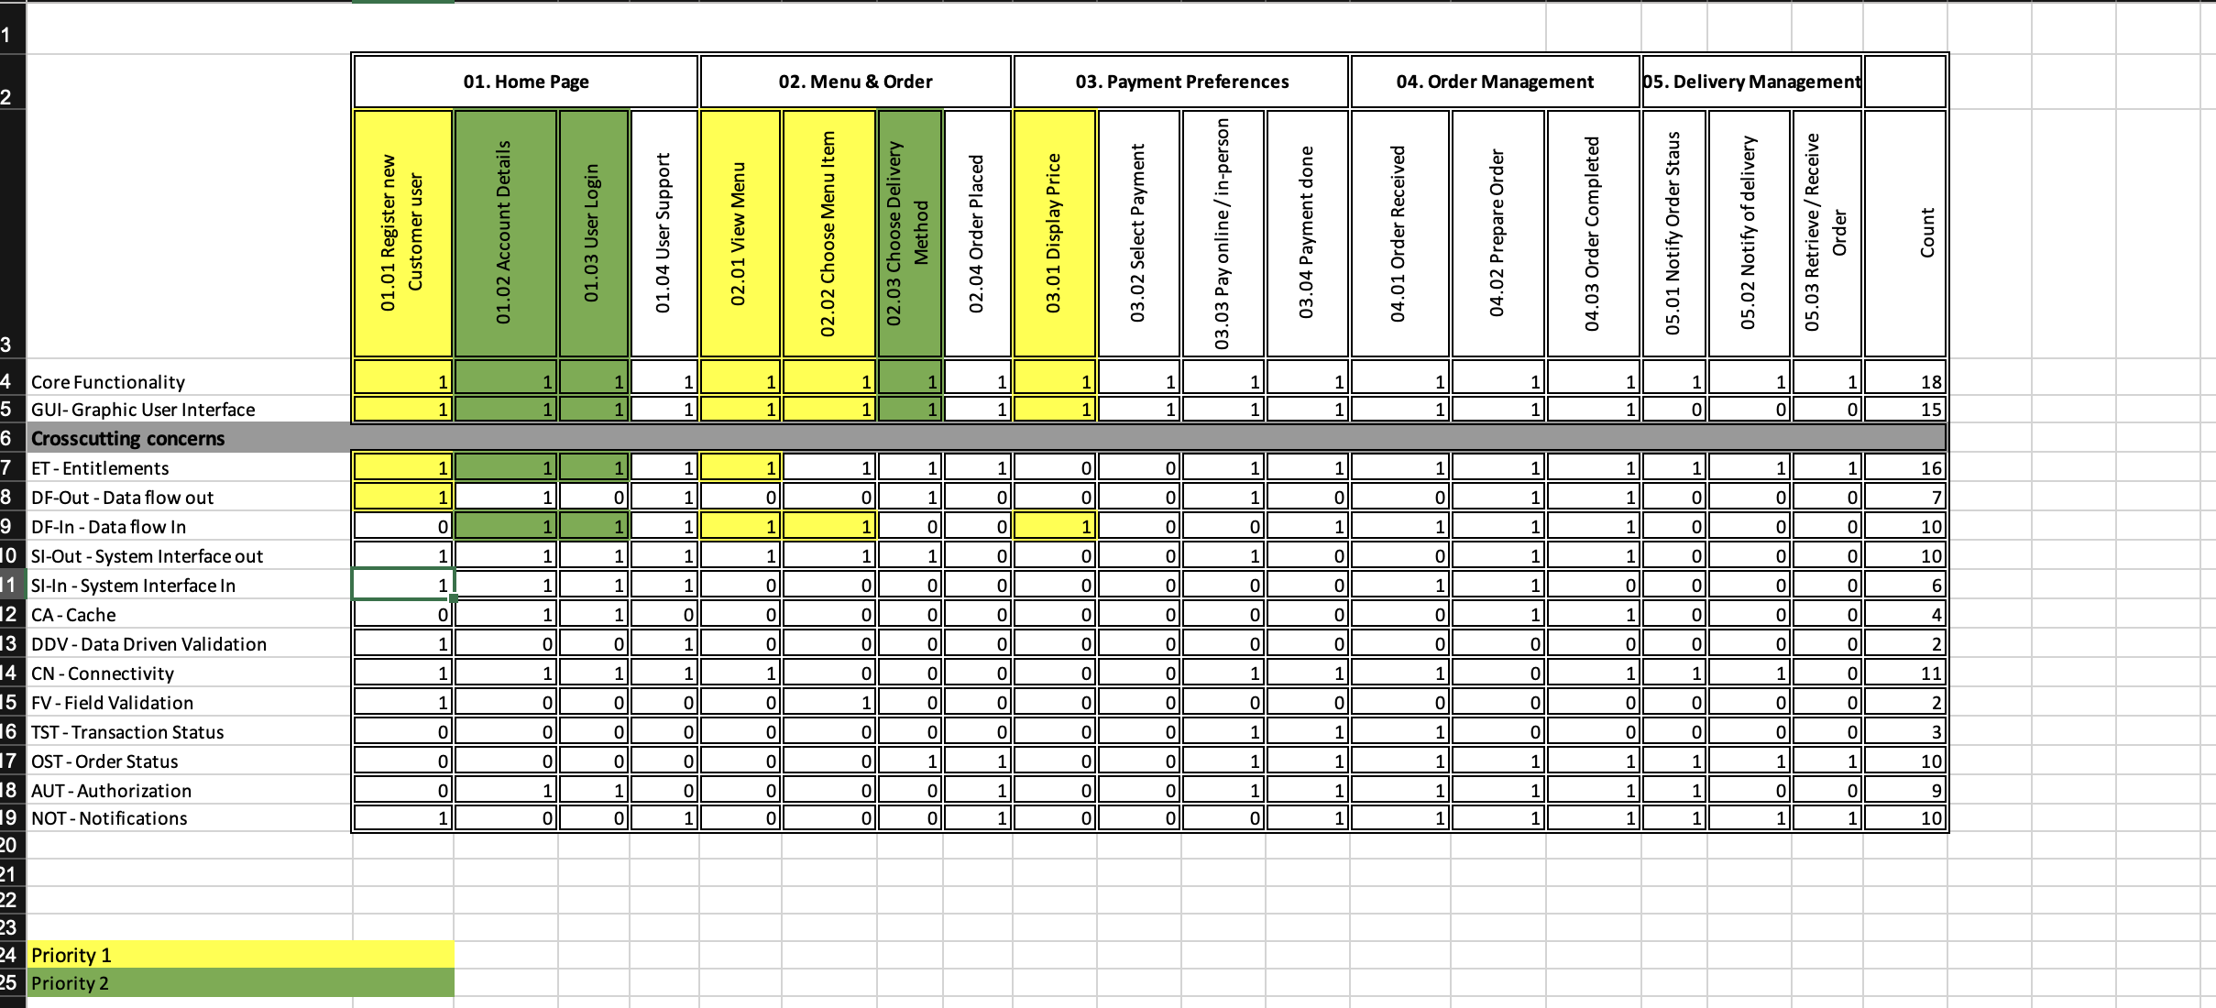
RCT - Gaëlle

Slide 6
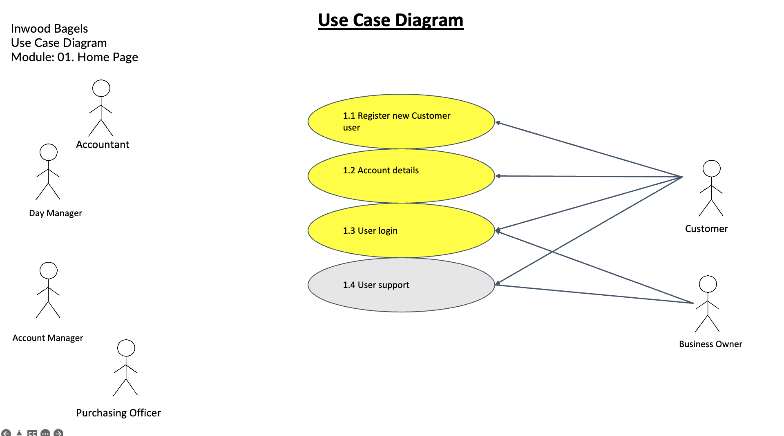
Use Case Diagram - hemaswi

Slide 7
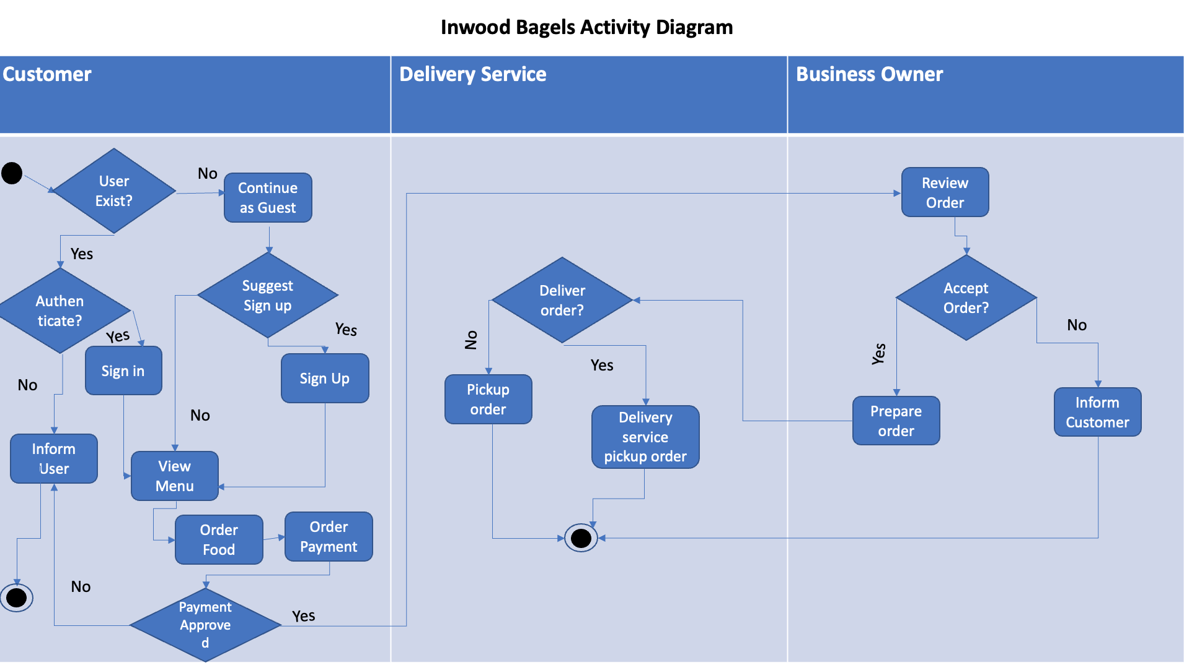
Activity Diagram - Brinda

Slide 8
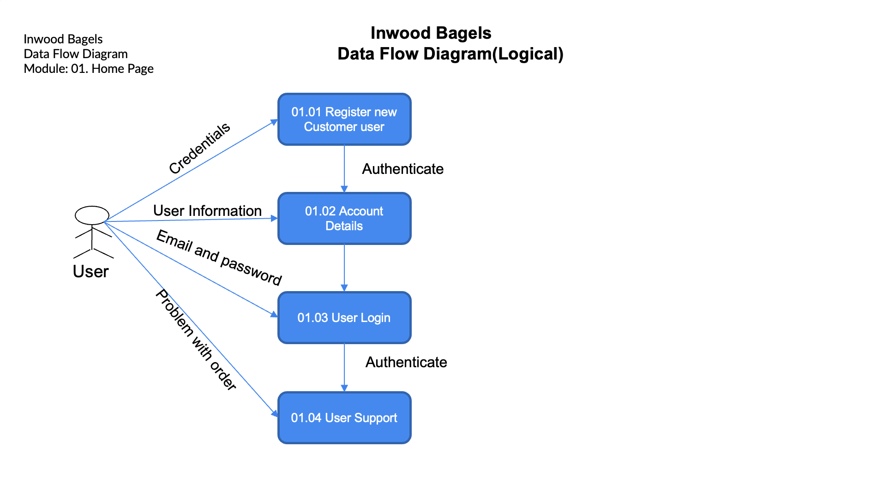
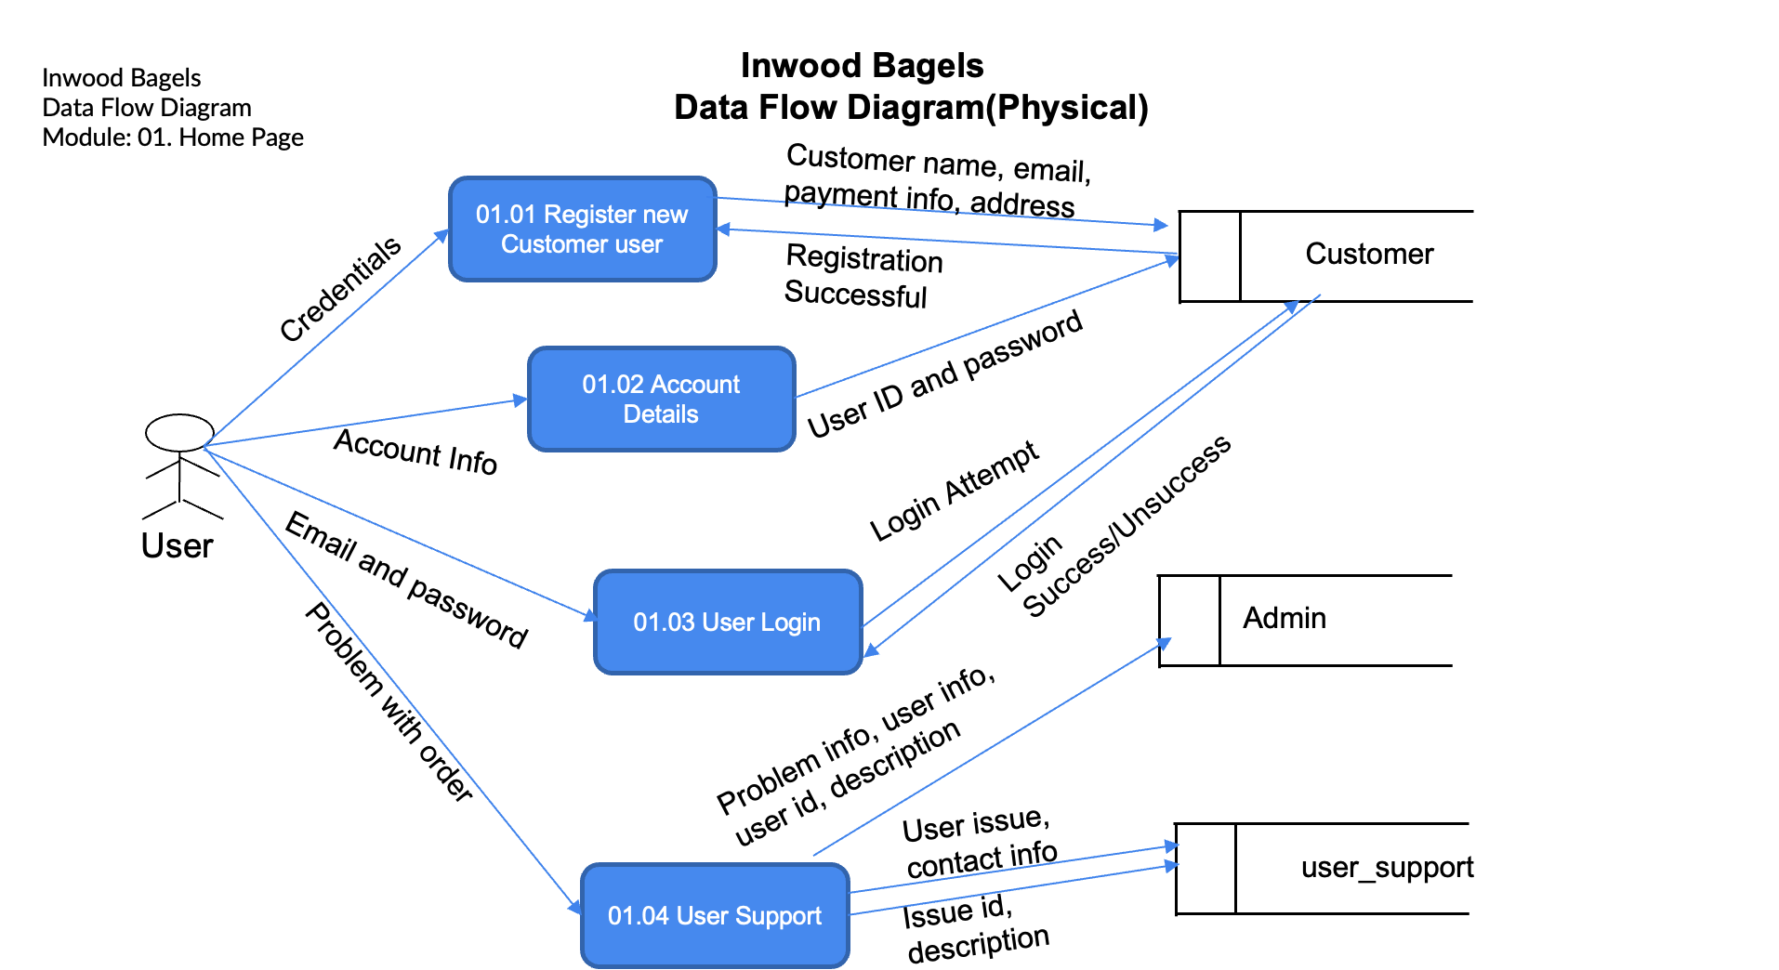
Data flow diagram (logical & physical) - Nandu

Slide 9
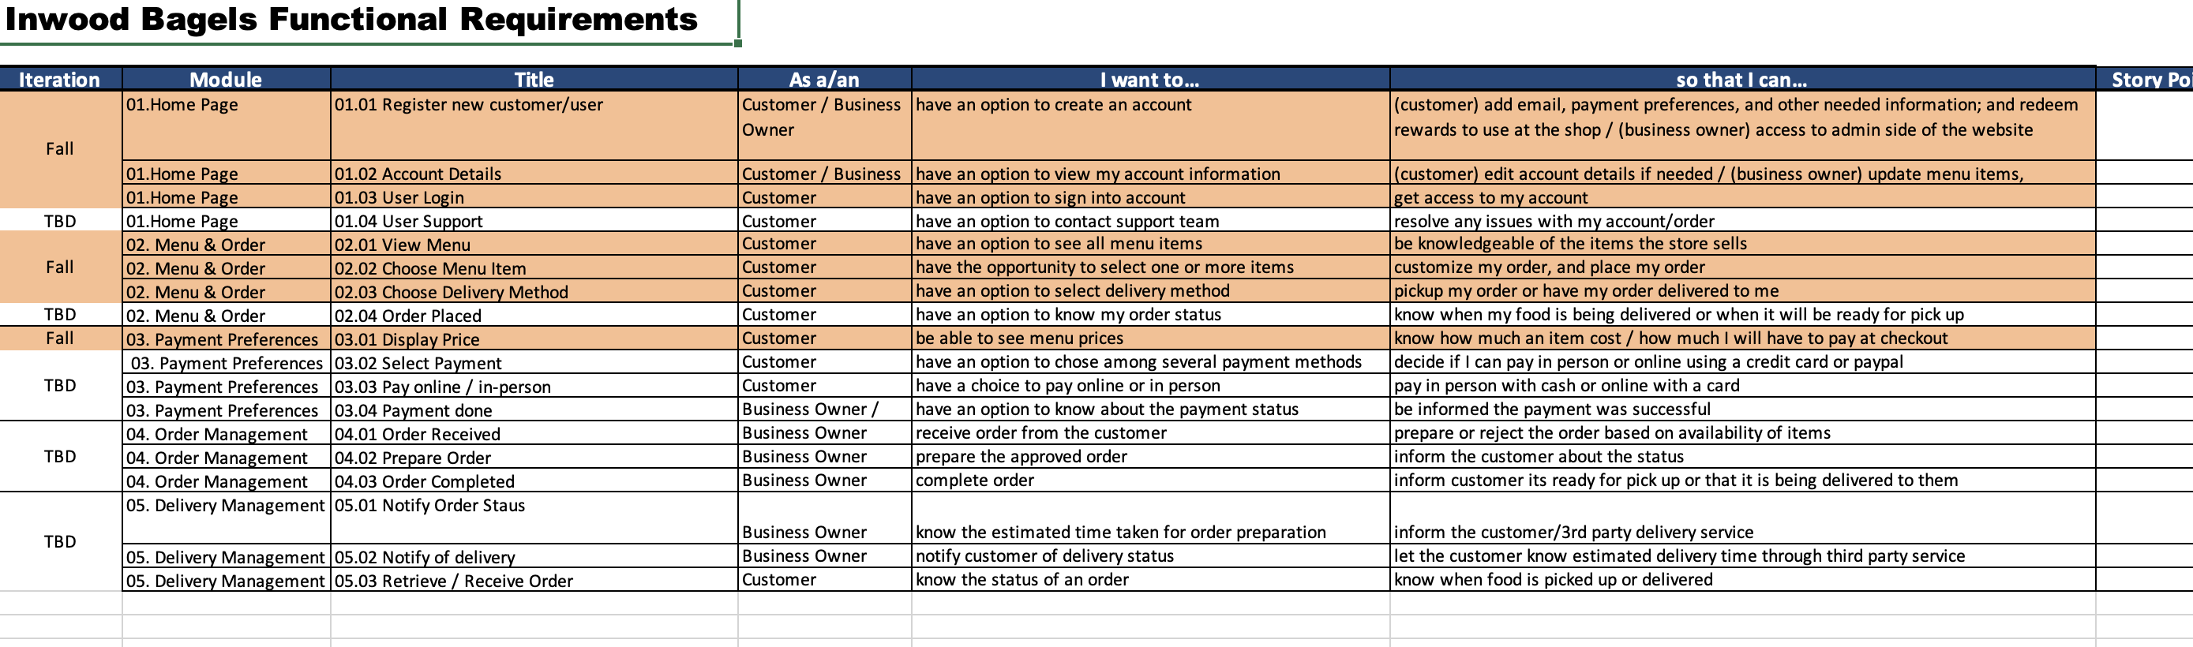
Functional Requirements (User stories) - Gaëlle

Slide 10
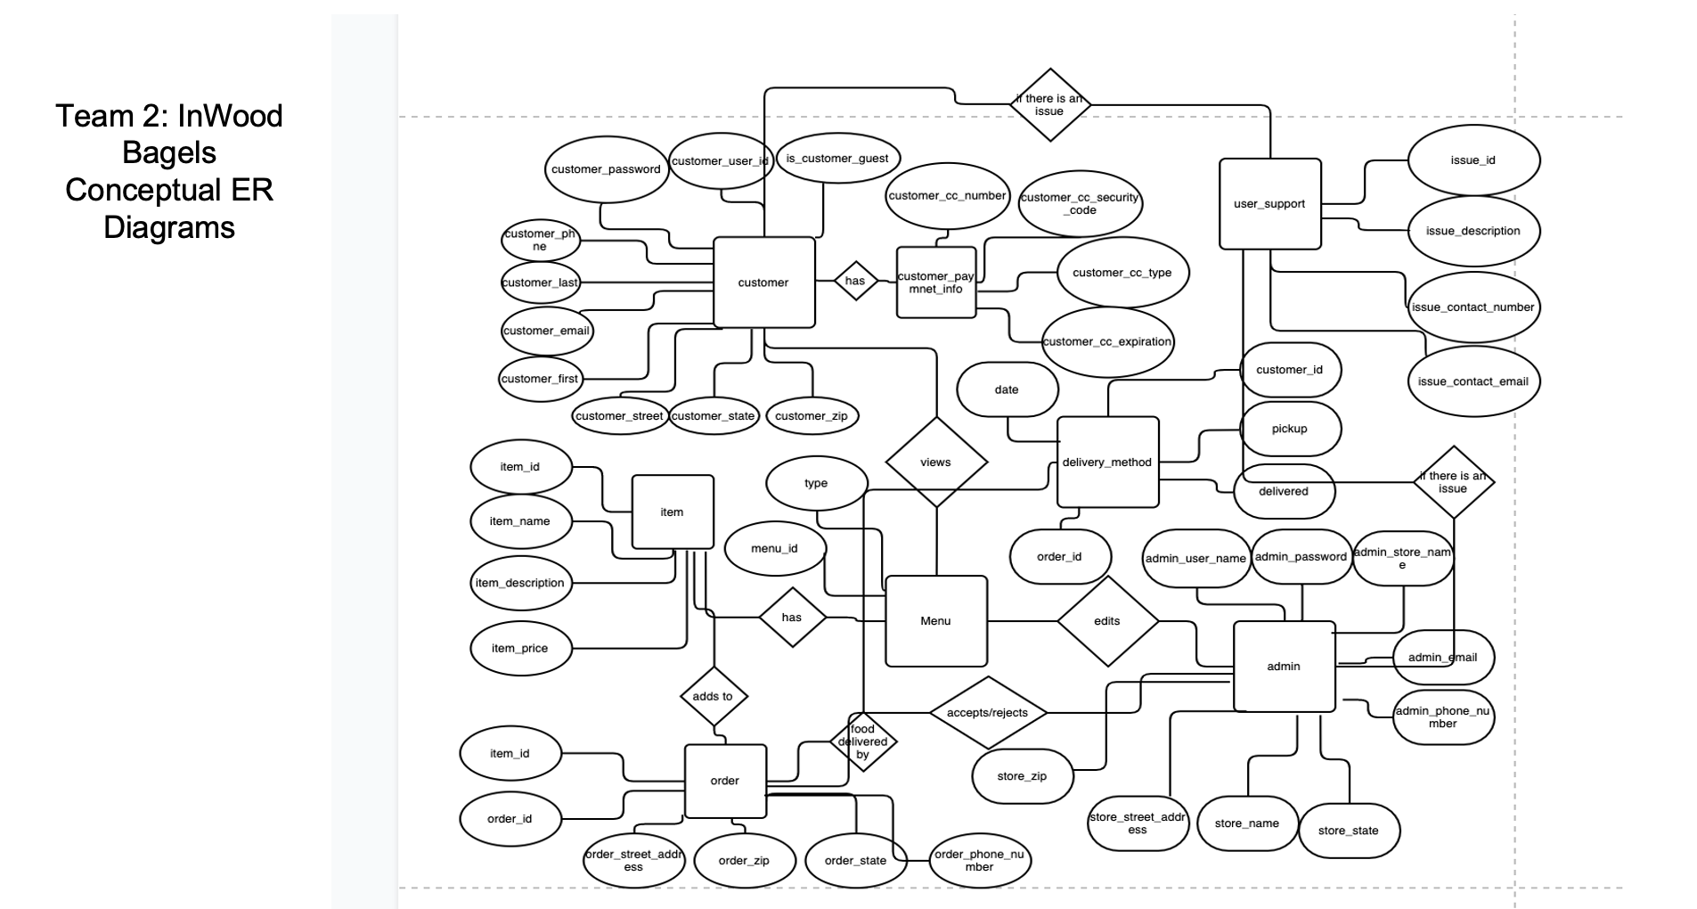
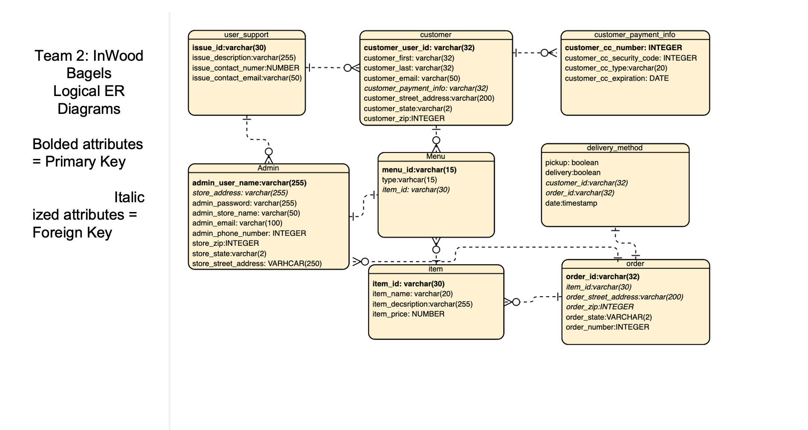
ER Diagrams (Conceptual & logical) - Noah

Slide 11
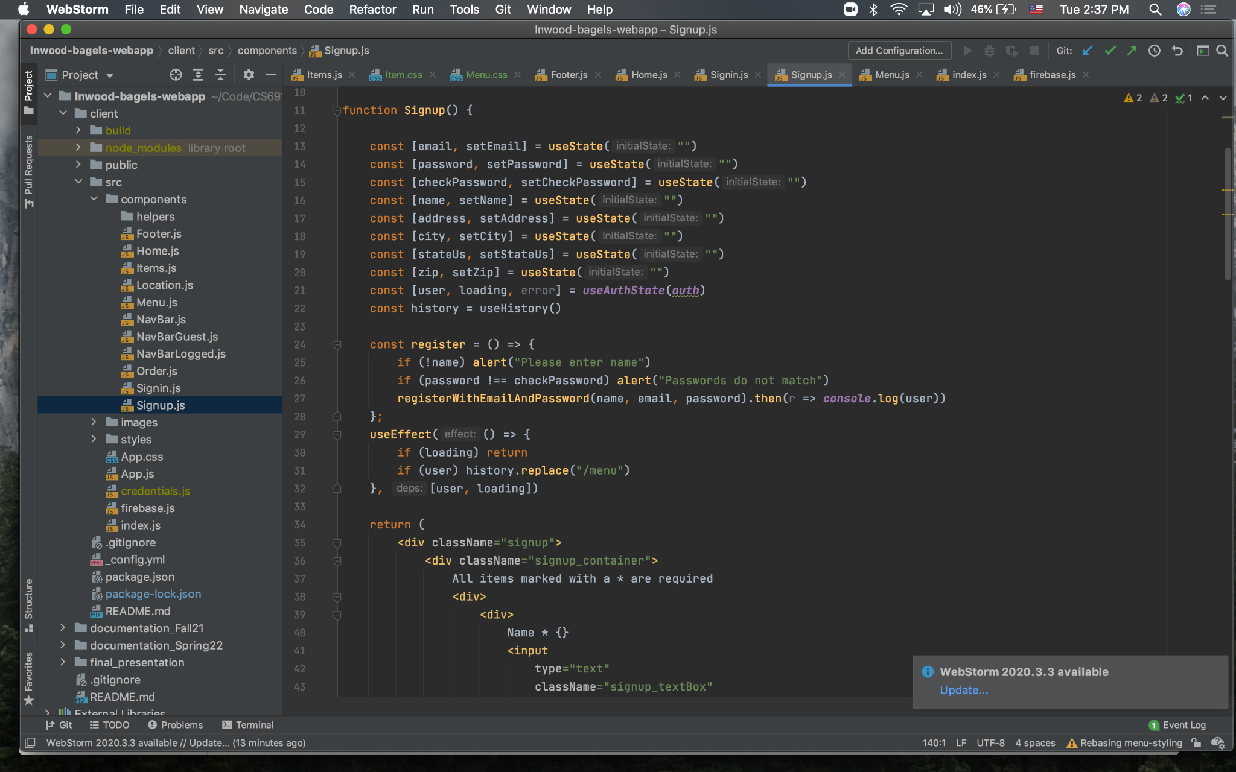
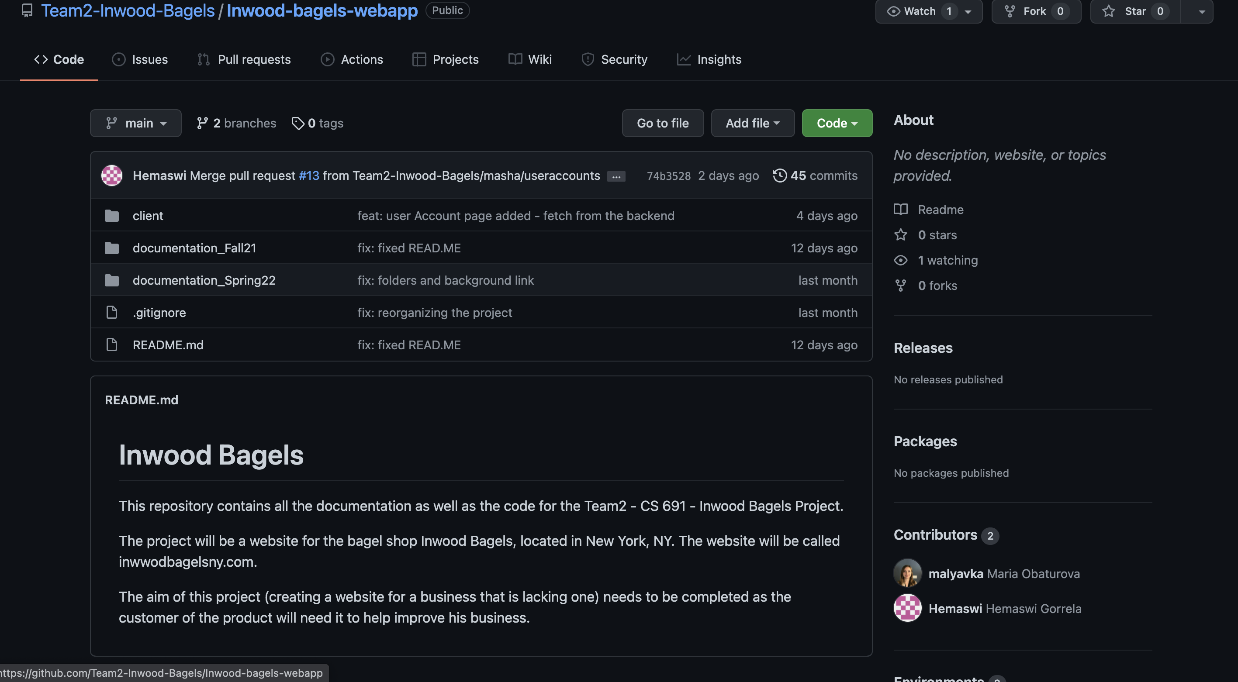
Source code example & Github Repo - masha

Slide 12
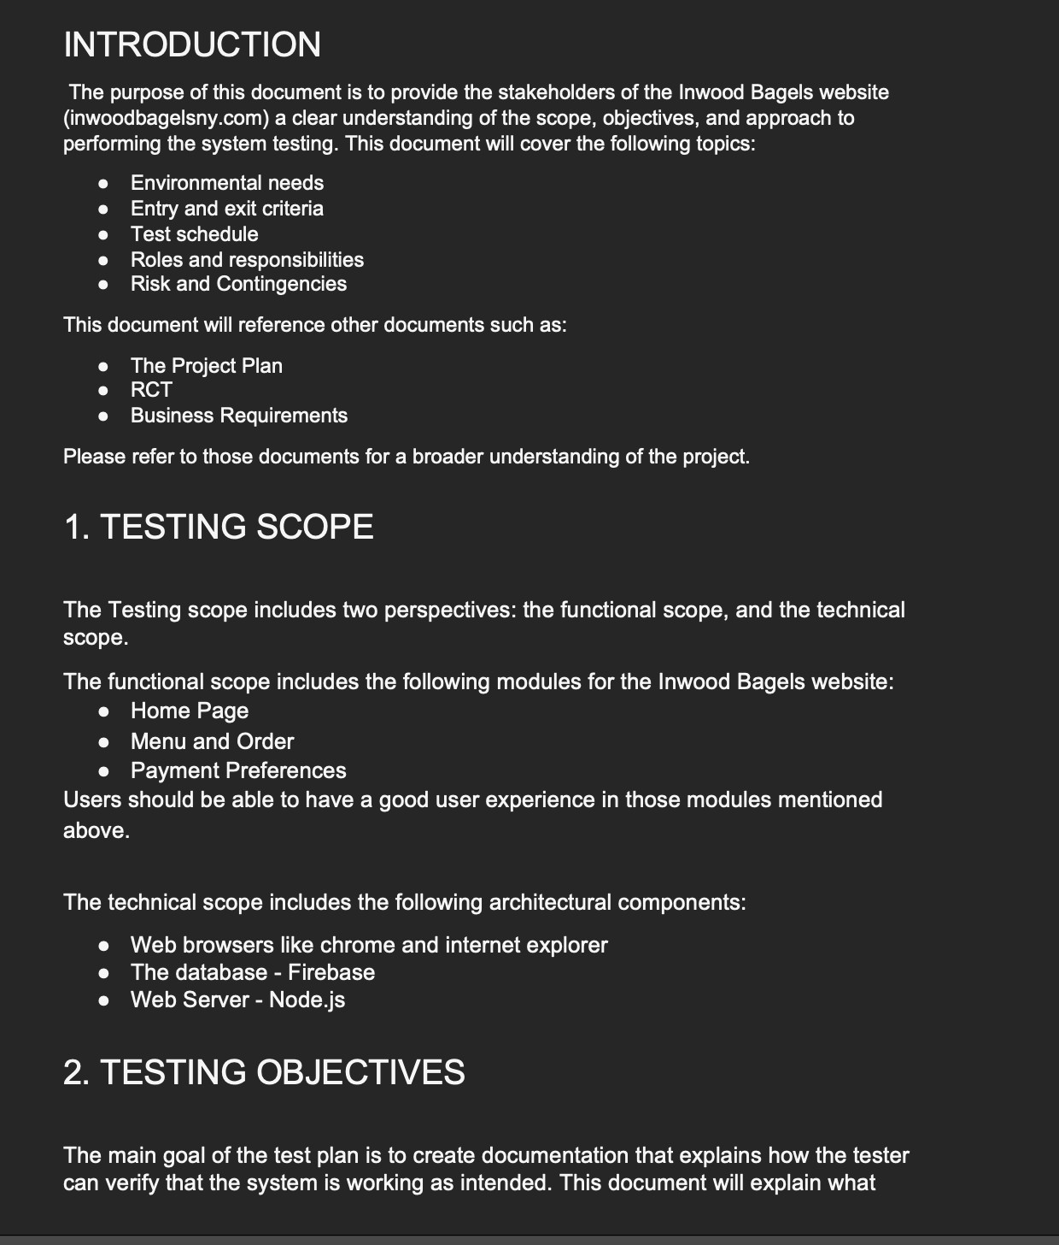
Test Plan Document- Abhilash

